Slide 1
http://bit.ly/WHgJUR

Slide 2
JMR 101
August 28, 2014

Slide 3

The School
Great Teachers!
  100% Highly Qualified
  33% National Board Certified
  43% Graduate Degrees
  13.6 Average Years of Experience

Slide 4
The School
Front Office
  Principal – Mike Miliote
  Assistant Principals
    Alison Fisch – 6th grade
    Fredericka Green – 7th grade
    Amy Burton – 8th grade
  Guidance Counselors
    Shari Cockerham – 6th grade
    Maria McCourt – 7th grade
    Gigi Jenouri – 8th grade
  Other admin/support staff
    Diane Dixon– front desk secretary
    Amy Boguski – registrar
    Tammy Smith – financial secretary
    Vikki Earnhardt - attendance

Slide 5
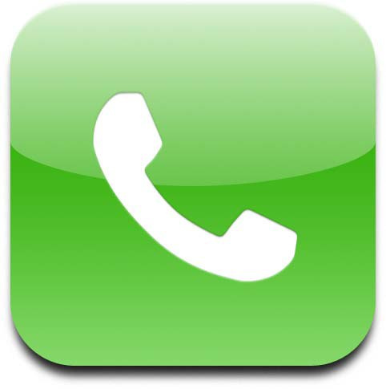


The Word
Communications
  No printed newsletter home!!
  Website – www.cms.k12.nc.us
  Charger Chatter – weekly online newsletter
  ListServ – by grade
    Register at the JMR website, Parent Info tab
  ConnectEd
  Facebook
  Twitter
  M

Slide 6
Keeping Informed about Your Child
Power School
  CMS Website
  Parents Tab
  Parent Portal
  PowerSchool Parent Portal (create an account)
Conferences
Teacher Websites
Tutoring

Slide 7

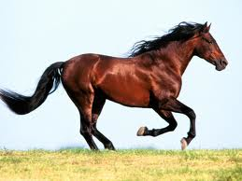
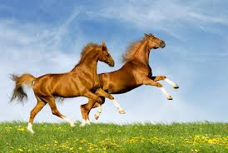
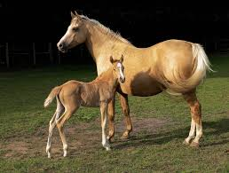
The Calvary
Each grade is divided into teams. The teams consist of a science and social studies teacher and two language arts and two math teachers.
6th – Colts, Broncos and Mustangs
7th – Blazers and Rangers
8th – Mavericks and Thoroughbreds

Slide 8
The School
Volunteer Run Welcome Desk
  The heartbeat of the school

Slide 9

The Rules
Late Arrival
  Tardy bell is 8:10am
    Any child arriving after 8:10 MUST be accompanied in by a parent and signed in at the Welcome Desk
Early Dismissal
  Child MUST bring a note to Welcome Desk that morning stating when/why leaving early.
  Child receives early dismissal note to take to appropriate teacher
  Child must manage getting to Welcome Desk on time
    NO calls made to classroom to get child out of class
  Parent picking up child must show photo ID
  Children returning to school must have parent sign them back in
Latest early dismissal is 2:45 pm
Absence
  Contact school via email robinson.attendance@cms.k12.nc.us
  Will get a Connect Ed call from attendance office if nothing is done
  Will be marked as unexcused if no contact by parent to school

Slide 10
The Rules
The Rules
Drop off items
  Items may be dropped off @ Welcome Desk
  Label items
  Remind your student to bring their early dismissal note to the welcome desk in the morning.
  Students are only called to the Welcome Desk in the afternoon. If your child forgets something (i.e. lunch, homework, pe uniform) please remind to look at Welcome Desk as they walk by on way to lunch.
  We do have a security camera in place, please be patient!

Slide 11
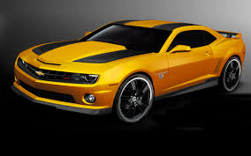
The Rules
Carpool
  2nd driveway from either direction
  2 lines, alternate merge at the turn – AM & PM
  Drop off only @ front of the building
  Pull ALL the way forward before dropping off
  NO CELL PHONES
  The sun in morning is difficult – use caution

Slide 12
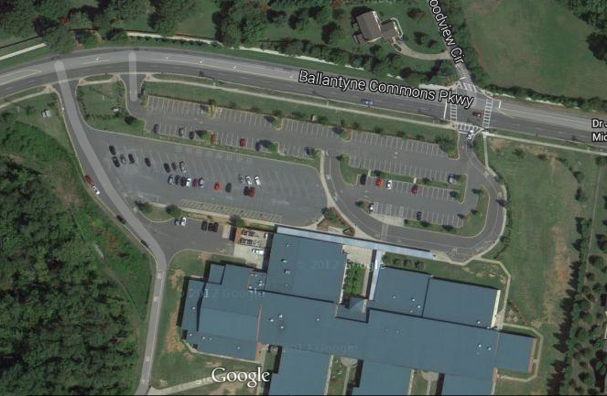

Slide 13
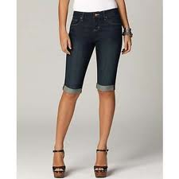
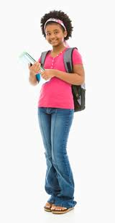
The Rules
Dress Code
  No short or revealing clothing. Skirts, dresses and shorts should end no more than 2 inches above the knees
  No shirts exposing the stomach, excessively tight tops or off the shoulder tops
  No low cut or revealing tank tops or shirts
  Sleeveless tops must be at least 3 fingers wide at straps
  No visible under garments
  No offensive/gang related graphics or slogans
  No extreme hair color (bright red, yellow, green, purple, blue)
  No headgear (scarves, caps, hoods, etc)
  No facial piercings
  Flip flops are permitted, but must have sneakers for PE

Slide 14
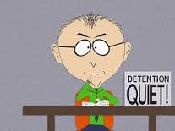
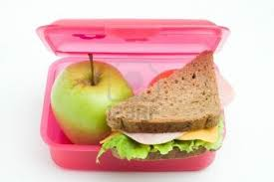
The Rules
Lunch detention
  For minor infractions – talking in class, missed homework, 3 unexcused tardies, etc.
  Kids get lunch, sit at an assigned table and work on homework/just eat if infraction is not homework related.

Slide 15
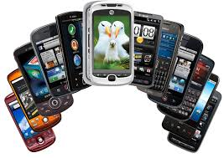
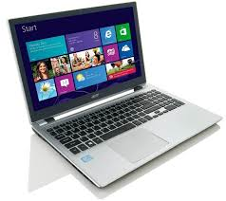
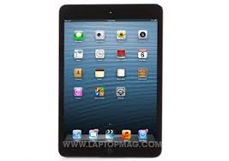
BYOT
Bring Your Own Technology
Appropriate use of student personal devices are outlined in the JMR BYOT Policy.
BYOT Policy is located on school website.
Students will receive a copy to sign. Students will not be able to use personal devices until signed document is returned to homeroom teacher.
Consequences for non-compliance outlined in policy.
Students can keep technology in locker until needed.

Slide 16
Robinson Languages…
SEM-R
Recharge
Intramurals
EC-Exceptional Children
ESL-English as a Second Language
AAP-Academic Assistant Program

Slide 17
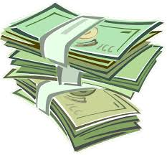
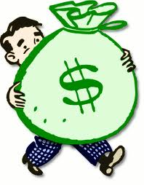
The Funds
Charger Challenge – annual giving campaign
  Funds additional teaching materials, I-pads & peripherals, software updates, etc.
  Corporate matching is a BIG part of our campaign
Easy Money
  Trash for Treasure
  Corporate rebates
    Relink VIC – school #4940
    Target
    Bi-Lo
  Fall and Spring student events – Rocktoberfest, Rec 4 Tech

Slide 18
The Activities
NCASA-North Carolina Association for Scholastic Activities
We are the 1st in the state for 2 years in a row!!!!
While CMS prohibits 6th graders from participating in sports, there are plenty of opportunities for them to get involved at JMR
  YCI
  Musical – 1st semester
  Encore Singers – 2nd semester
  Science Olympiad
  Math Counts
  Chess Club
  Shakespeare Recitation – Dec thru Feb
  Girls on the Track
  Apply for NJHS in May
  The Quill
  Twelve
  Art Showcase

Slide 19


Your Chance
Volunteer opportunities – sign up via volunteer form in parent pack
SLT
PTA
  Board – on website
    Committees – Need your participation/help
      Media Center
      Welcome Desk
      Cafeteria Monitors
      Hospitality
      Book Fair
      8th Grade Celebration
      Copy Shop

Slide 20

Register To Volunteer
www.cmsvolunteers.com

Slide 21
Breathe,
Be Calm,
Trust Us!

